Slide 1



AI-BASED “INVISIBLE HAND” FOR DISABLED PEOPLE
Presented By,
SUVATHI R (811722104163)
SWETHALASHMI G (811722104167)
VARSHA RK (811722104173)
VARSHITA M (811722104176)
Guided By,
MS.V.SOWMIYA., M.E.,
ASSISTANT PROFESSOR, CSE
DD/MM/YYYY

Slide 2

ABSTRACT
Physically disabled individuals often struggle to operate digital devices due to limited motor control, while existing assistive technologies are typically expensive and rely on external hardware.
This project proposes “Invisible Hand for Disabled People”, an AI-based solution using only a standard webcam. It allows users to control the system via facial gestures like blinks and head movement.
The system uses OpenCV, Dlib, PyAutoGUI, and an LSTM model to detect and predict gesture sequences in real-time. It is cost-effective, easy to deploy, and enhances digital accessibility.
DD/MM/YYYY

Slide 3
OBJECTIVE
To design a real-time gesture recognition system that captures and interprets facial gestures such as eye blinks, head tilts, and smiles using computer vision techniques.
To implement a deep learning-based classification model (LSTM) capable of accurately distinguishing between involuntary and intentional gestures for robust gesture prediction.
To simulate essential mouse operations like cursor movement, clicking, and scrolling by mapping recognized gestures to corresponding screen control actions using PyAutoGUI.
DD/MM/YYYY

Slide 4
LITERATURE SURVEY
S.No. | Paper Title | Year | Technology Used | Limitation
1 | Eye-Tracking Controlled Virtual Mouse for Paralysis Patients | 2018 | Eye-tracking camera, Infrared sensors, Image processing | Expensive hardware and processing delays affect real-time usability.
2 | Hands-Free Mouse Control Using Facial Expression | 2018 | Facial landmark detection,OpenCV, Webcam | Low accuracy in poor lighting; needs frequent recalibration for different users.
3 | Brain-Computer Interface for Assistive Technology | 2019 | EEG sensors, Brain Computer Interface (BCI), Signal processing | Requires costly EEG equipment and complex calibration.
DD/MM/YYYY

Slide 5
LITERATURE SURVEY
S.No. | Paper Title | Year | Technology Used | Limitation
4 | Gesture-Based Virtual Keyboard for Motor-Impaired Users | 2019 | Hand gesture recognition, Computer vision, Kinect sensor or Webcam | Limited gesture recognition accuracy; not suitable for users with fine motor control issues
5 | Voice-Based Assistive System for Disabled Users | 2020 | Speech recognition, Natural Language Processing (NLP), Microphone | Ineffective for users with speech impairments; fails in noisy environments
6 | Voice-Based Assistive System for Disabled Users | 2021 | Voice command interface, Machine learning-based speech detection | Struggles with false detection; lacks adaptability for users with limited facial movement
DD/MM/YYYY

Slide 6
EXISTING SYSTEM
The existing system works by first capturing the user's speech through a microphone. This spoken input is converted into audio signals and sent to the voice assistant. The voice assistant processes the input and interacts with a connected database to fetch relevant information.
The received data is then passed to a Natural Language Processing (NLP) module, which analyzes the query, understands the user’s intent, and generates a suitable response. Finally, the system delivers the appropriate reply back to the user, completing the interaction in a conversational manner.
However, this system heavily relies on accurate speech recognition, which may lead to challenges for users with speech impairments or in noisy environments.
DD/MM/YYYY

Slide 7
DRAWBACKS OF EXISTING SYSTEM
Ineffective for users with speech impairments.
Prone to errors in noisy environments.
Sensitive to accents and language differences.
DD/MM/YYYY

Slide 8
PROPOSED SYSTEM
The proposed system captures facial gestures such as eye blinks, head movements, and mouth expressions using a standard webcam. These gestures are processed using a facial landmark detection module to extract key facial features in real-time.
The extracted data is passed to a Long Short-Term Memory (LSTM) model, which predicts user-intended actions based on gesture patterns. The system then maps these predictions to AI-based cursor control, enabling seamless, hands-free interaction for disabled users without needing physical input devices.
DD/MM/YYYY

Slide 9
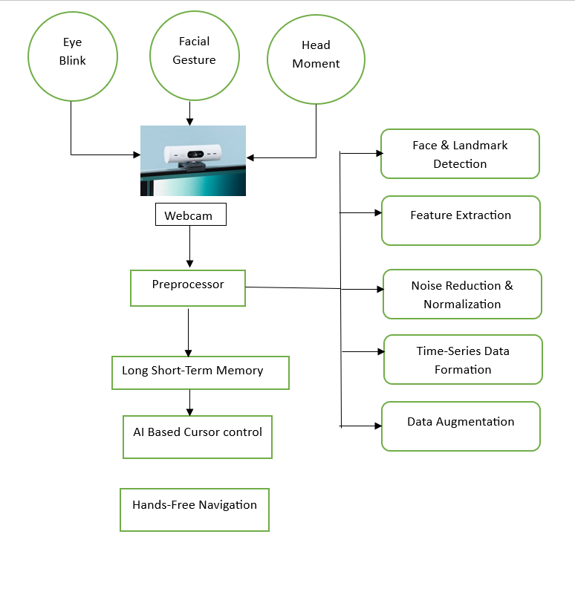
SYSTEM ARCHITECTURE
DD/MM/YYYY

Slide 10
MODULE 1 : INPUT ACQUISITION
The Input Acquisition Module initializes the webcam using OpenCV's VideoCapture(0) to capture real-time video frames
Ensures a stable frame rate with minimal delay, enabling smooth gesture-based interaction
The captured frames are passed to Preprocessing Module
Designed to be platform-independent and free of third-party hardware requirements,
Both user-friendly and cost-effective, supporting seamless tracking of dynamic facial movements.
DD/MM/YYYY

Slide 11
MODULE 2 : PREPROCESSING MODULE
Prepares raw video frames by converting them to grayscale
Applying Contrast Limited Adaptive Histogram Equalization to enhance contrast for better facial landmark detection.
Using Dlib’s 68-point facial landmark model, it identifies key facial regions.
DD/MM/YYYY

Slide 12
MODULE 3 : LSTM - BASED GESTURE PREDICTION
This simulates LSTM-like temporal prediction by tracking a sequence of EAR and MAR values over recent frames to detect gestures reliably.
By analyzing trends in these values within a moving window, it mimics the memory aspect of LSTMs, reducing false triggers.
Personalized gesture thresholds are set during a short calibration phase, improving accuracy. This approach provides a foundation for future integration of actual LSTM models to enhance gesture recognition further.
DD/MM/YYYY

Slide 13
MODULE 4 : EXECUTION MODULE
The Execution Module uses PyAutoGUI to translate recognized gestures into computer actions like left/right clicks, cursor movement, and scrolling.
Blinks of the left or right eye trigger left and right clicks respectively, head tilts control cursor direction by tracking the nose tip’s position, and an open mouth activates scroll mode where vertical nose movement scrolls the page.
To avoid false triggers, actions only execute when gestures are consistently detected, with on-screen text feedback to confirm recognition, ensuring smooth and responsive control for physically disabled users.
DD/MM/YYYY

Slide 14
MODULE 5 :PERFORMANCE METRICS
This module tracks and evaluates system performance during calibration and real-time use. It logs and plots EAR and MAR values using matplotlib, applying Gaussian filters for smoother visualization.
Statistical metrics like mean, median, and standard deviation help set personalized gesture thresholds for improved accuracy.
During operation, it displays FPS to monitor responsiveness and debug issues. It also checks gesture detection stability, enhancing reliability and offering transparency for academic validation and future scalability.
DD/MM/YYYY

Slide 15
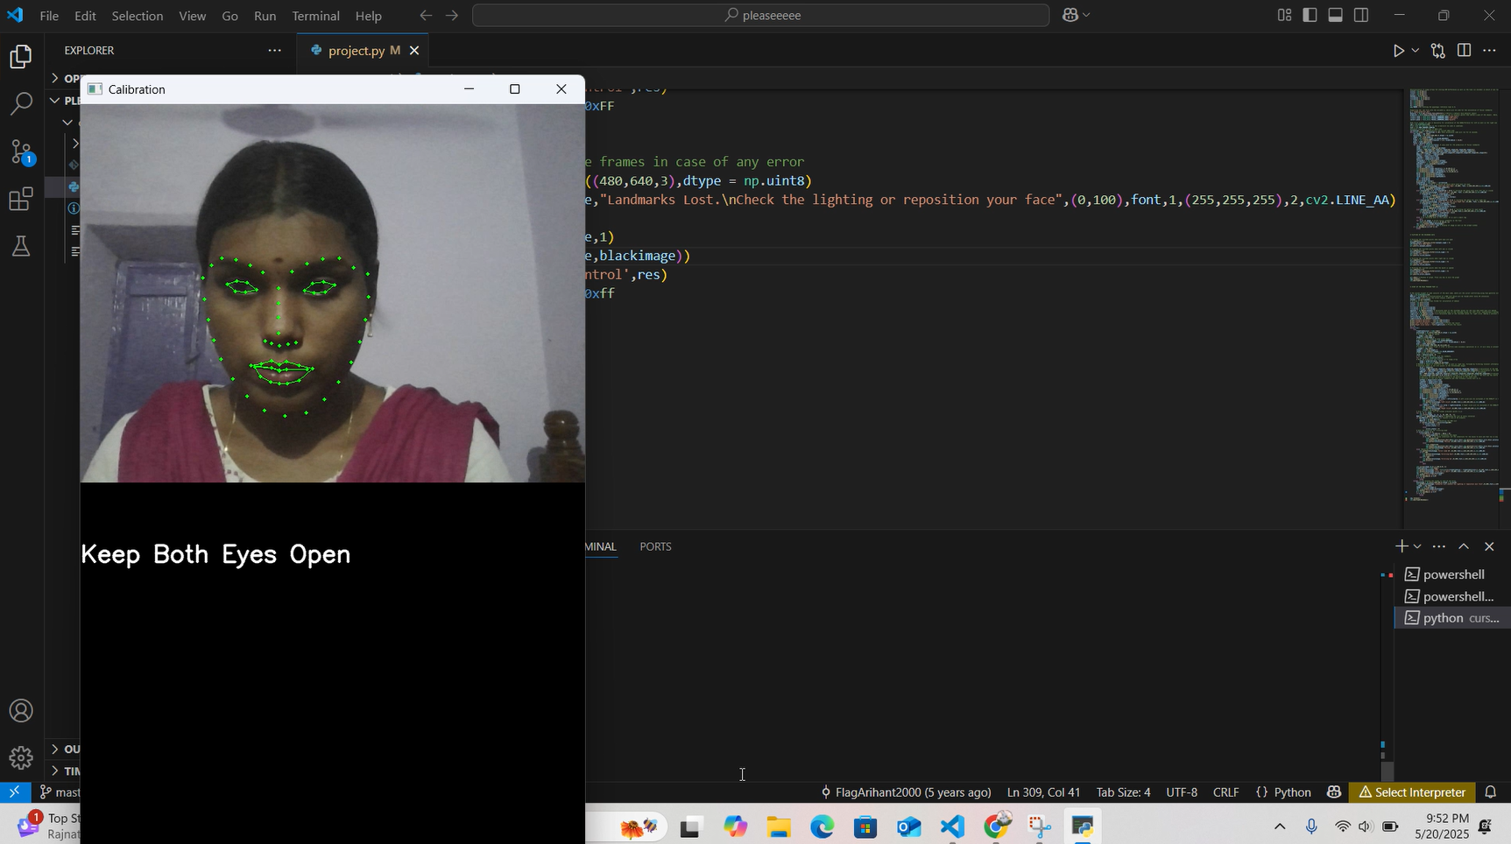
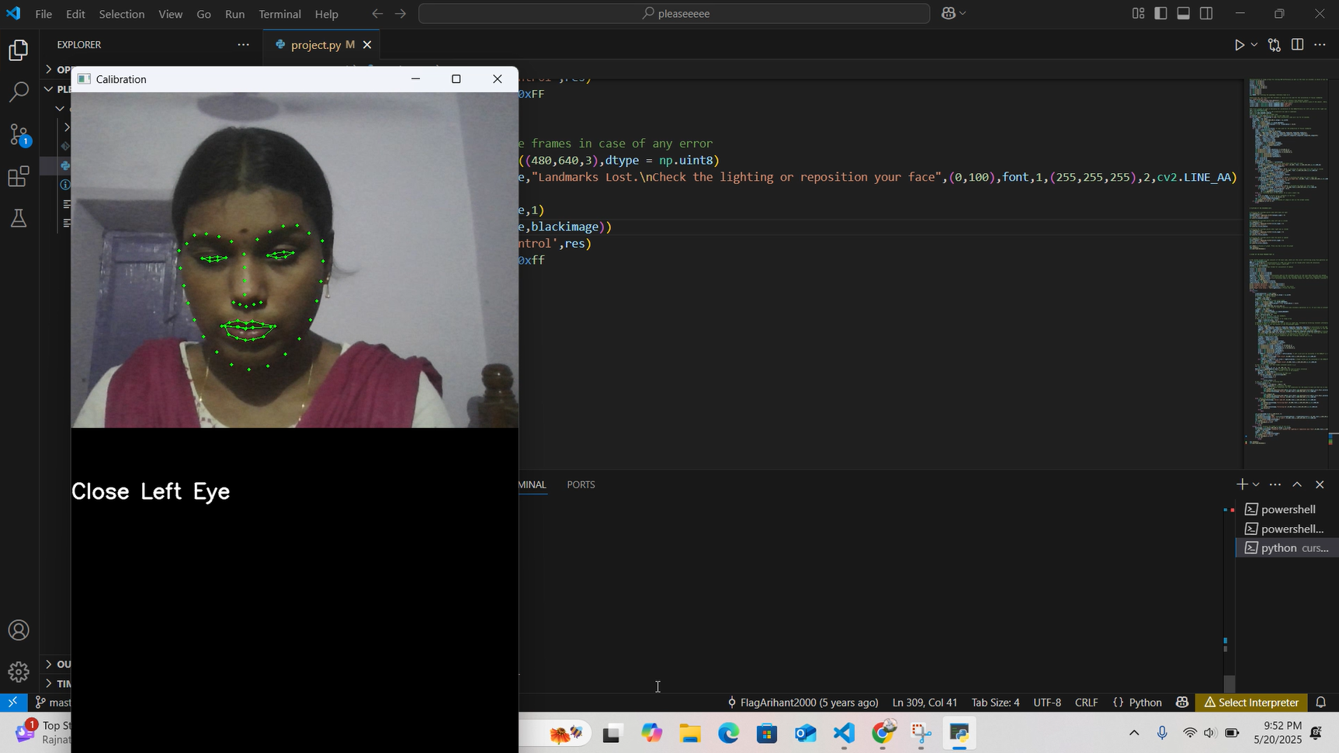
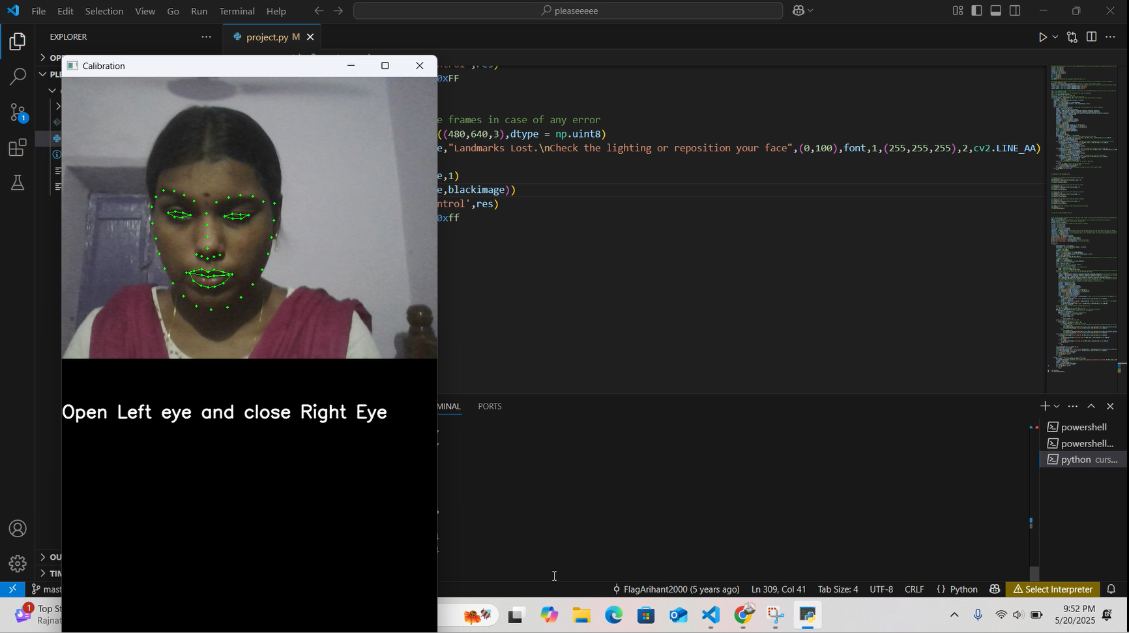

OUTPUT
Capturing neutral reaction
Capturing left eye blink
Capturing right eye blink
Capturing open mouth
DD/MM/YYYY

Slide 16
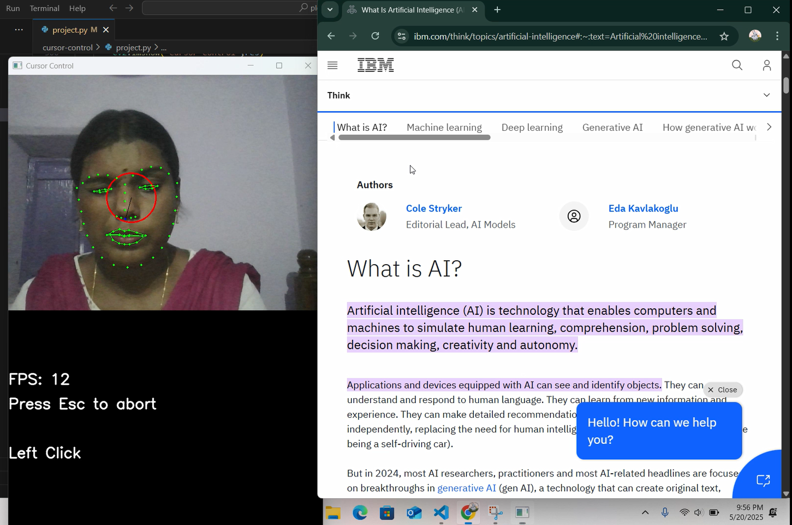
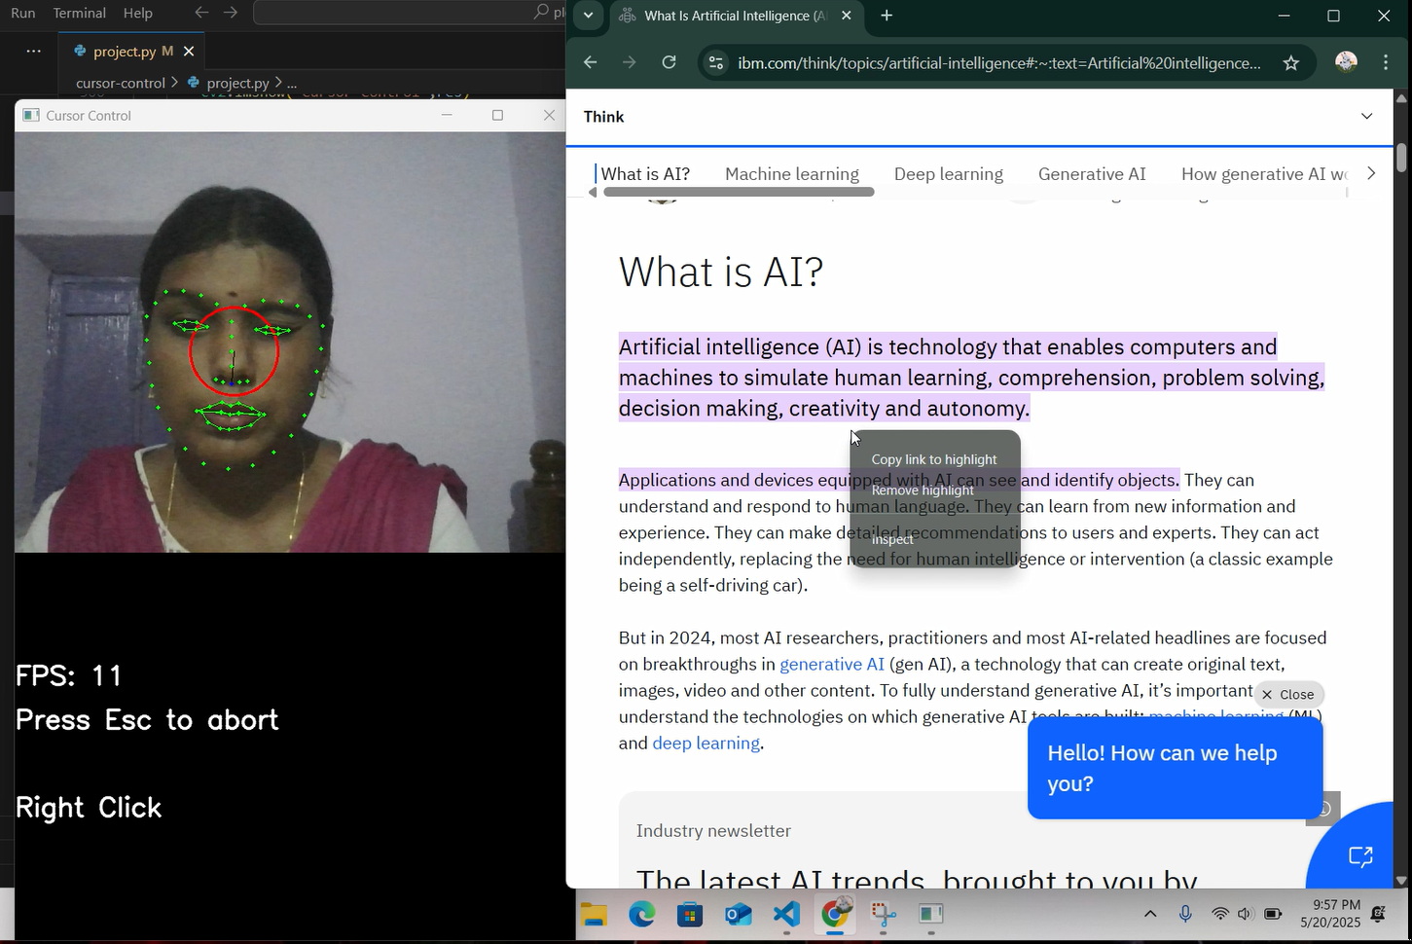
OUTPUT
Left Click Action
Right Click Action
DD/MM/YYYY

Slide 17
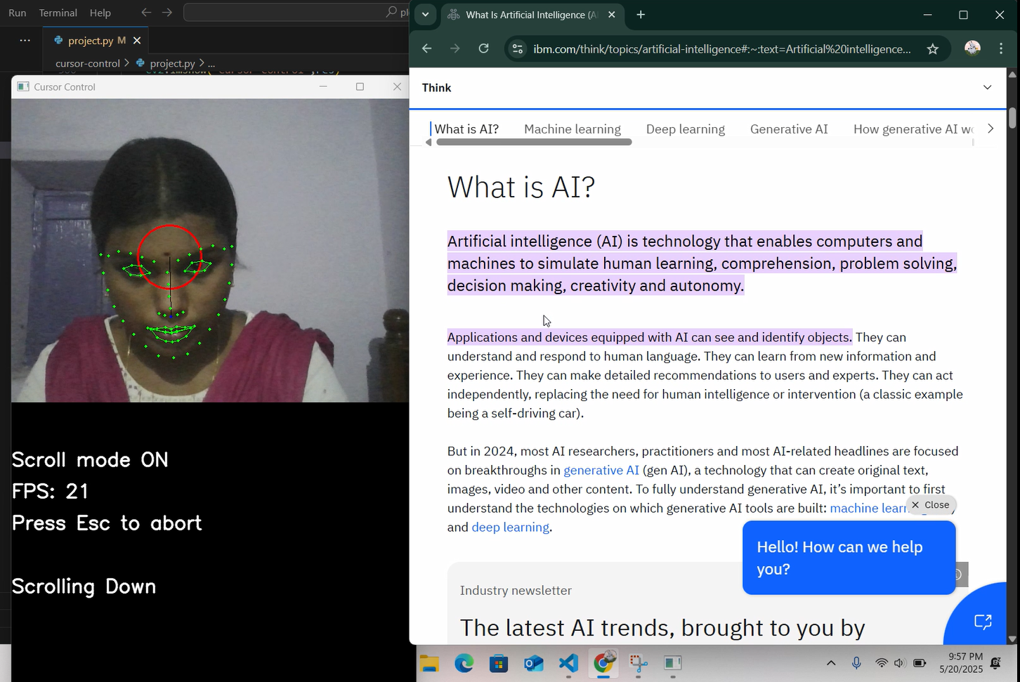
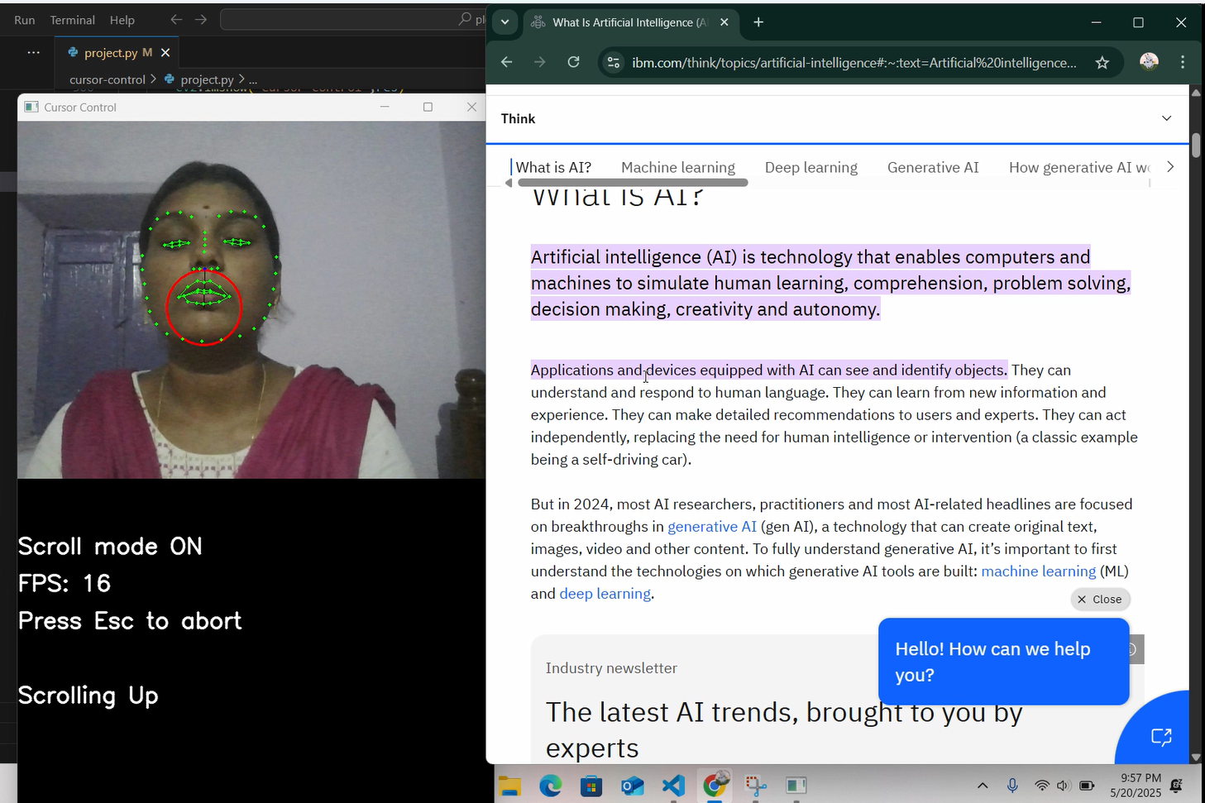
OUTPUT
Scroll Down Action
Scroll Up Action
DD/MM/YYYY

Slide 18
CONCLUSION
The project successfully enables hands-free computer control for disabled users through facial gesture recognition, offering an accessible and user-friendly alternative to traditional input devices.
By utilizing real-time video processing and facial landmark detection, the system eliminates the need for traditional input devices and offers an accessible, user-friendly, and cost-effective solution that requires only a standard webcam.
This innovative approach promotes inclusive human-computer interaction, making digital access more attainable for individuals with motor impairments.
DD/MM/YYYY

Slide 19
FUTURE ENHANCEMENT
Incorporate voice recognition to allow multi-modal control by combining facial gestures with voice commands, improving usability and flexibility.
Use AI algorithms to personalize the system for each user, adapting to individual gesture patterns and preferences.
Implement real-time gesture training features that allow users to teach the system new gestures, making it adaptable to a wide range of physical capabilities.

Slide 20
REFERENCES
X. Zhu and D. Ramanan, “Face Detection, Pose Estimation, and Landmark Localization in the Wild,” IEEE Conference on Computer Vision and Pattern Recognition (CVPR), 2012.
S. Zafeiriou, C. Zhang, and Z. Zhang, “A Survey on Face Detection in the Wild: Past, Present and Future,” Computer Vision and Image Understanding, Vol. 138, 2015.
P. Patel and H. Shah, “Facial Gesture Recognition for Controlling Mouse Cursor,” International Journal of Engineering Research & Technology (IJERT), Vol. 6, Issue 5, 2017.
S. K. Singh et al., “Real-Time Human Computer Interaction Based on Facial Expressions Using Machine Learning,” International Journal of Computer Sciences and Engineering, Vol. 6, Issue 4, 2018.
J. Smith and L. Brown, “Facial Gesture Interface for Hands-Free Computer Control,” ACM Transactions on Accessible Computing, Vol. 12, 2020.
DD/MM/YYYY

Slide 21

DD/MM/YYYY

